Slide 1
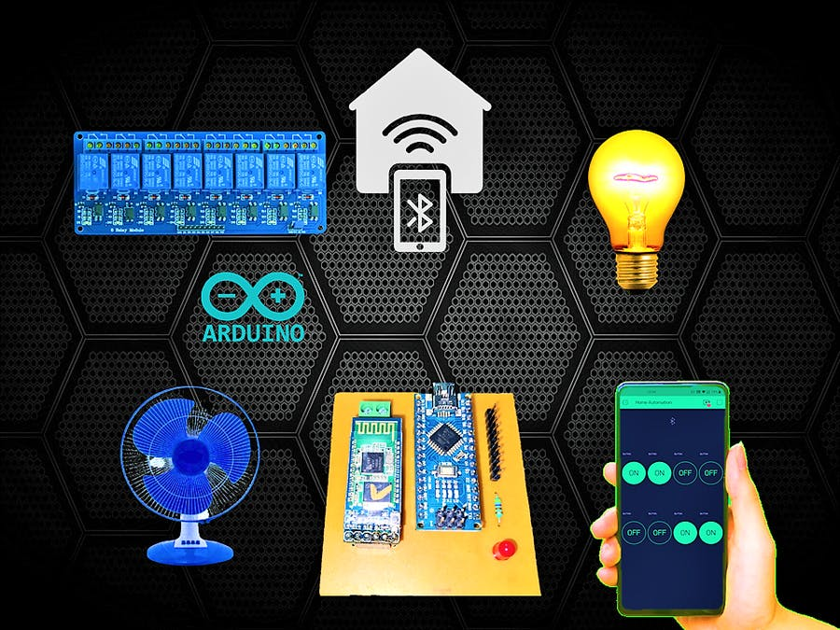

HOME APPLIANCES ROBOTIZATION

Slide 2
INTRODUCTION
Home Appliances Robotization is an IOT based project which allows you to control devices in your home from an android phone.
There is an increasing demand for smart homes, where appliances react automatically to changing environmental conditions and can be easily controlled through one common device.
This project presents a possible solution whereby the user controls devices by using their existing mobile phone, where control is communicated to the Arduino UNO from a mobile phone through its Bluetooth interface.

Slide 3
PROBLEM STATEMENT
Many times it becomes too tiring to operate the electrical switches manually every now and then. In those situations, application of home automation makes it possible to control them from a distant place in easy way with our smartphone. This is a big problem especially in case of aged or handicapped people. Disabled people are more likely to be exposed to daily life problems than other healthy people. This project can be developed to overcome their difficulties. It can also be used to support disabled people, providing safe, secure and empowering environments. The system can allow the user to control many features or automate them.

Slide 4
COMPONENTS
Hardware
Arduino UNO
HC – 05 Bluetooth Module
5 V Relay X 4
Jumper wires
Smartphone or tablet (Bluetooth enabled)
5V Power Source
Bulb, Fan and Socket
Software
Arduino 1.8.5 compiler
Android Application

Slide 5
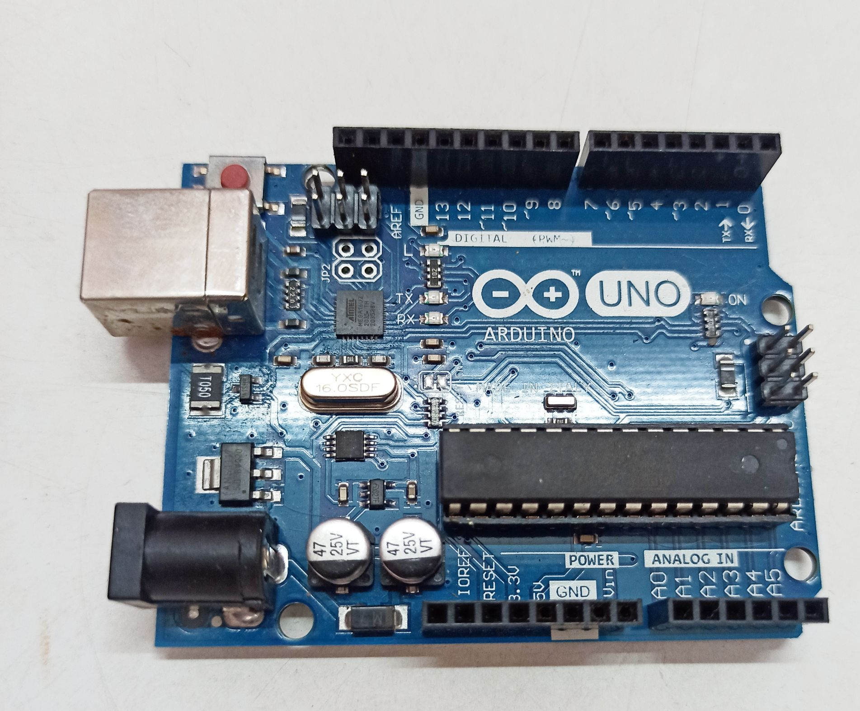
ARDUINO UNO
Arduino Uno is a 8-bit micrcontroller board
based on the ATmega328P. It has 14 digit input/
output pins (of which 6 can be used as PWM
outputs), 6 analog inputs, 16 MHz quartz crystal,
a USB connection, a power jack, an ICSP (In
circuit serial programmer) header and a reset button.

Slide 6
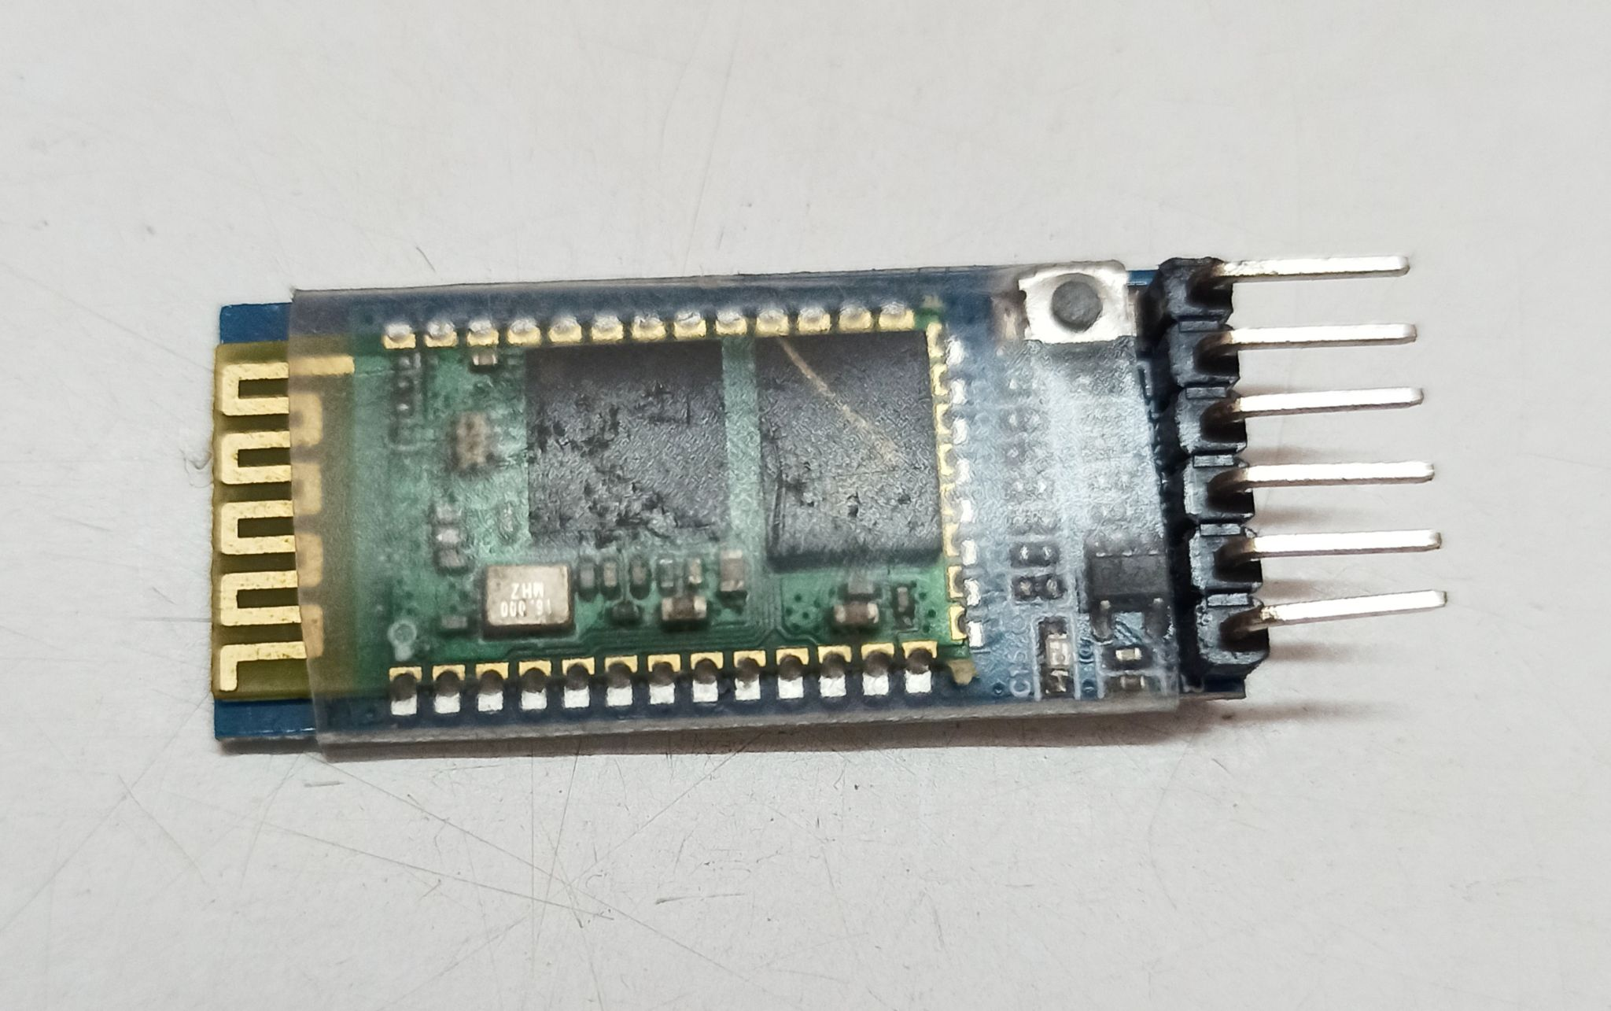
HC 05 Bluetooth Module
HC-05 module is an easy to use
Bluetooth SPP (Serial Port Protocol)
module, designed for transparent wireless
serial connection setup. HC-05 module has
6 pins i.e ENABLE, VCC, GND, STATE, TXD & RXD.

Slide 7
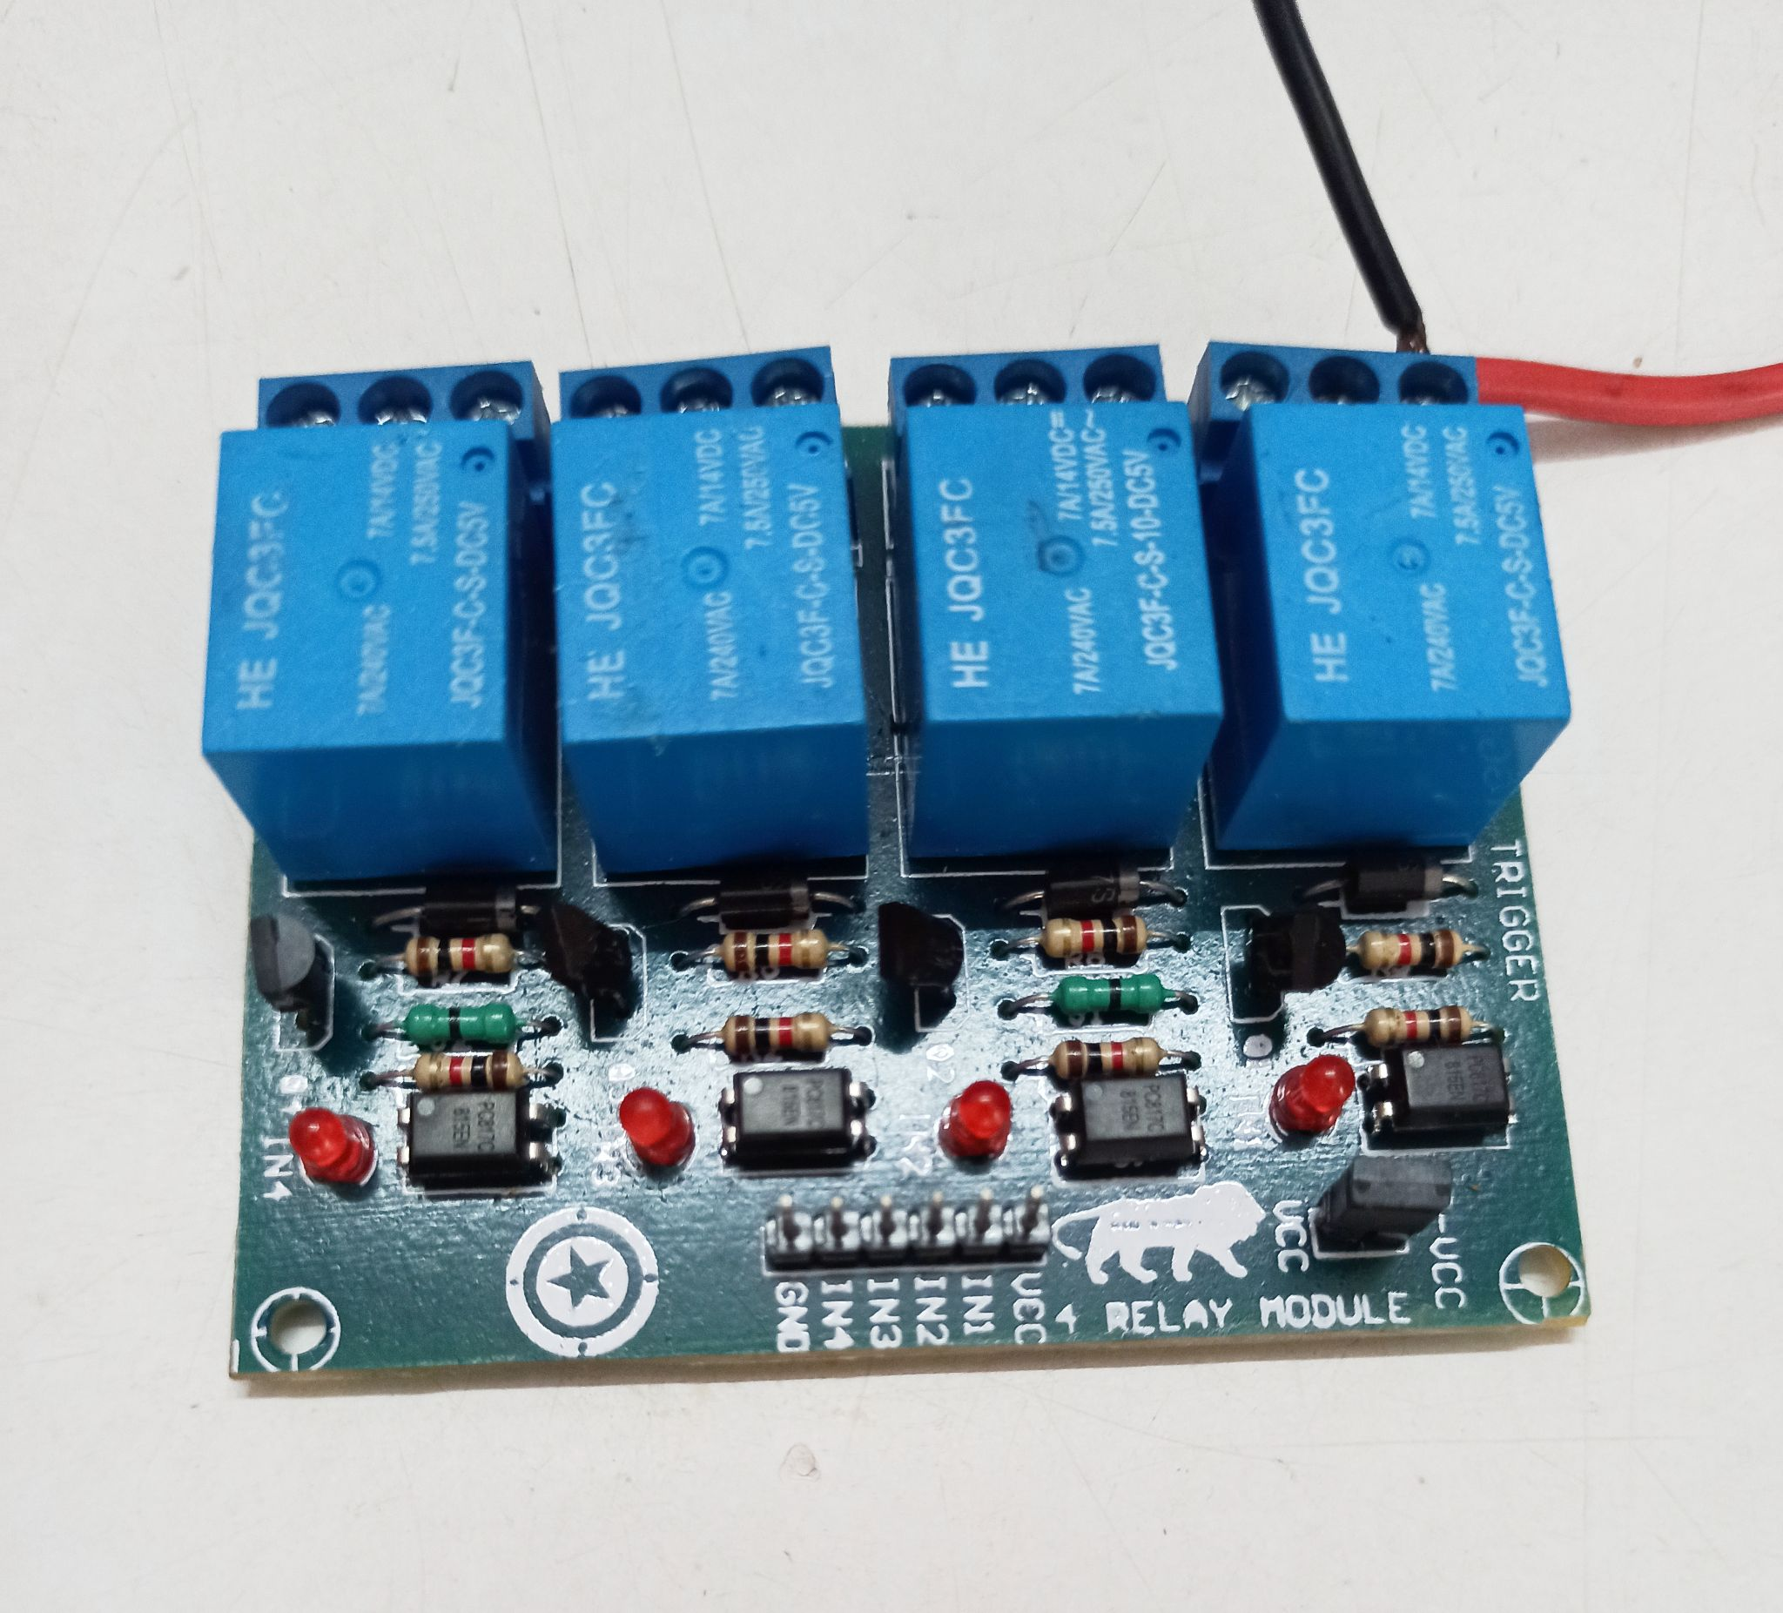
RELAY MODULE
A Relay is actually a switch which
is electrically operated by an electro-
magnet. The electromagnet is activated
with a low voltage, for example 5 volts
from a microcontroller and it pulls a
contact to make or break a high voltage
circuit.

Slide 8
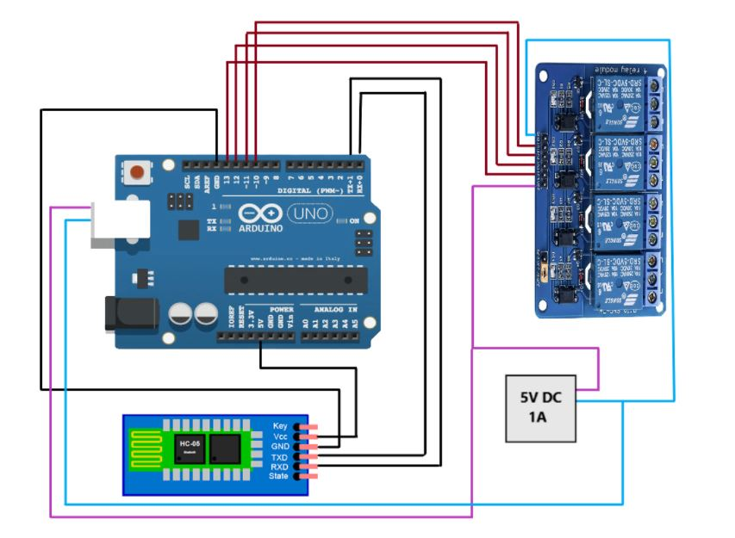
DESIGN AND IMPLEMENTATION
CIRCUIT DIAGRAM

Slide 9
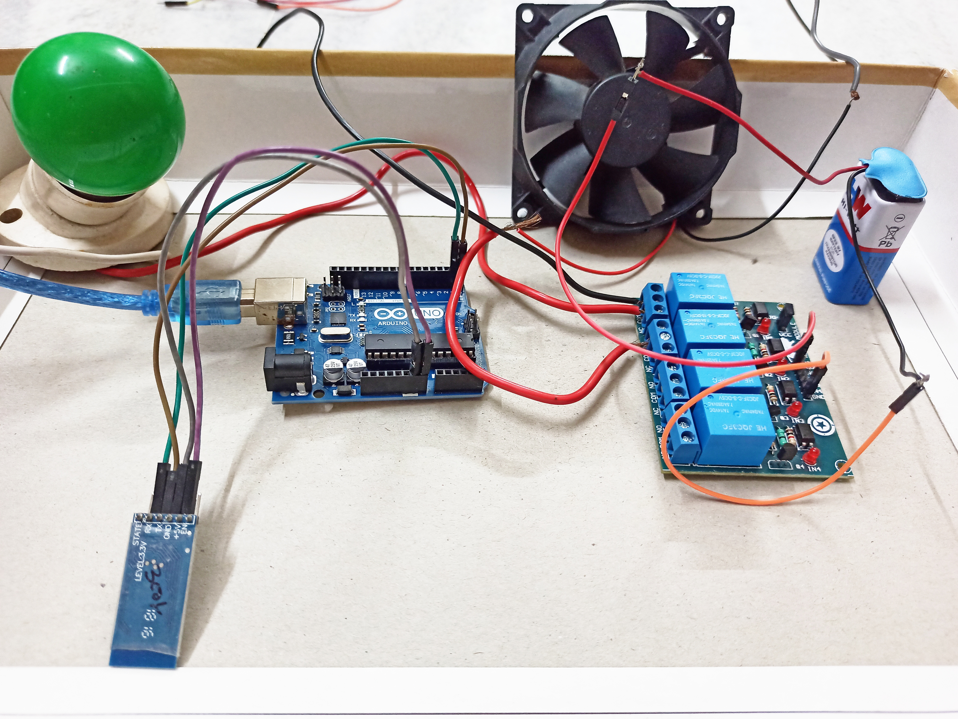
MODEL DIAGRAM
DESIGN AND IMPLEMENTATION

Slide 10
DESIGN AND IMPLEMENTATION
Home Appliances Robotization is designed which can be controlled by any smartphone.
The robotization system connects with the smartphone through Bluetooth.
The smartphone sends control signals to switch home appliances ON or OFF by an android app.
The application is capable of sending text strings to a paired device.
This application will pair with the home appliances system through HC-05 Bluetooth module.
The Arduino board receives the user commands in the form of numbers from the smartphone through Bluetooth interface.
These numbers are assigned to the home appliances and the appliances are toggled either ON or OFF on receiving the command.

Slide 11
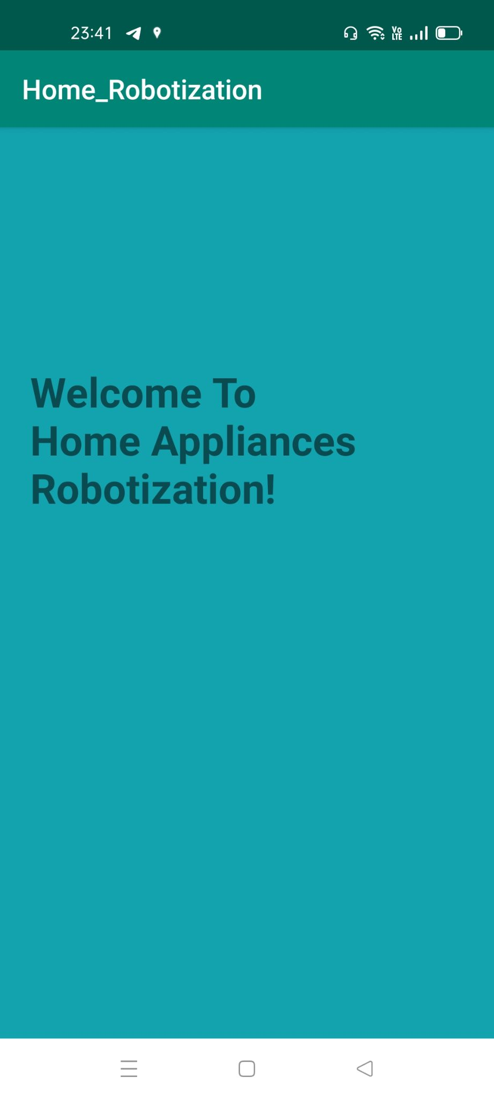
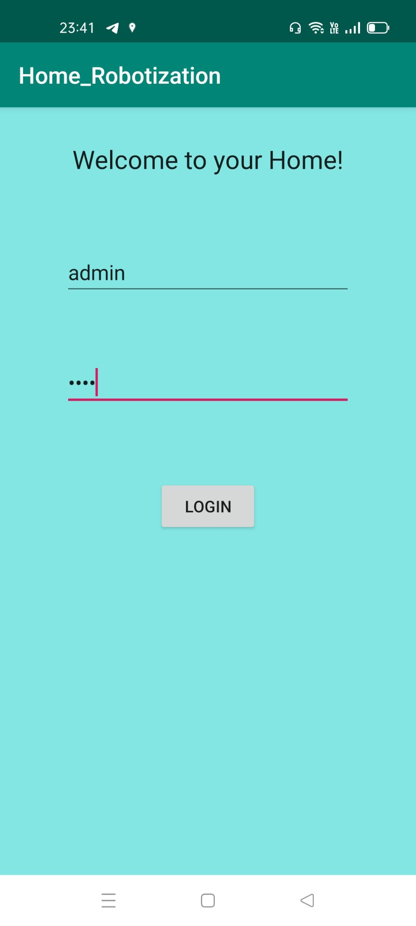
SCREENSHOTS OF APPLICATION

Slide 12
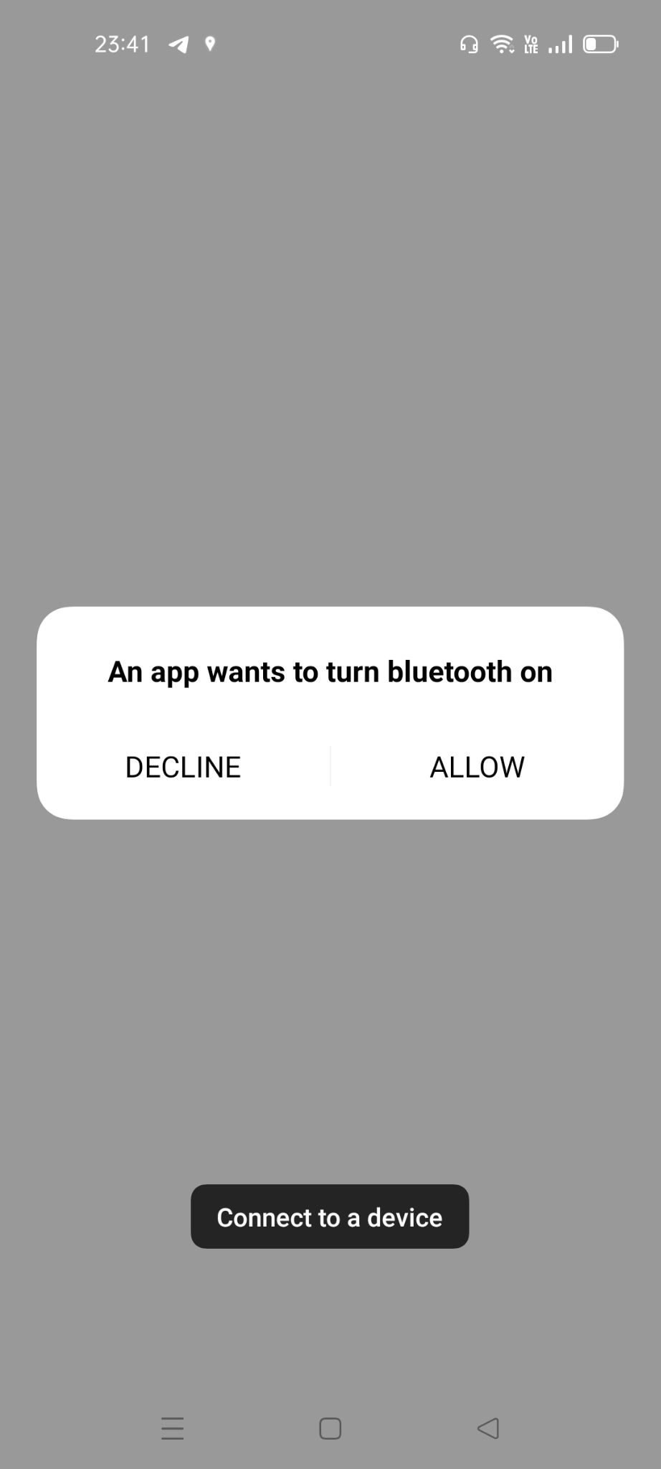
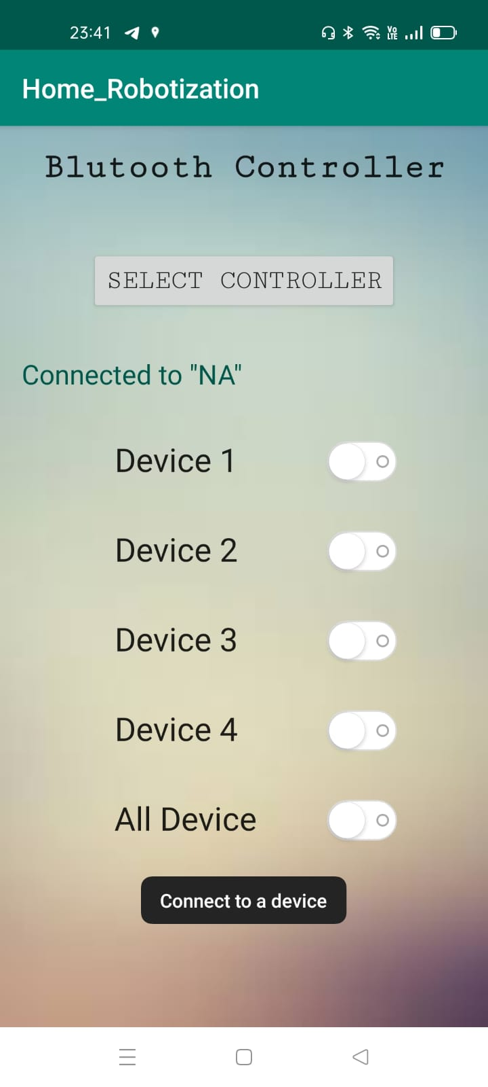
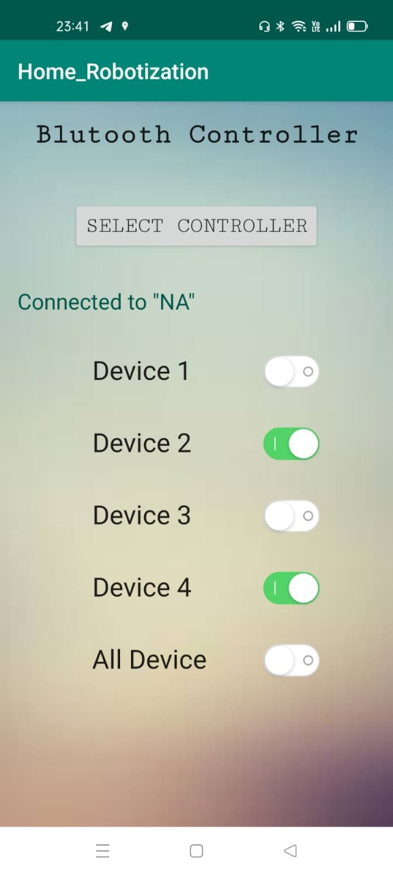

Slide 13
APPLICATIONS AND ADVANTAGES
1. This project can be used to control various Home Appliances.
2. We can control device from a long distance, thus it gives ease of access.
3. Home Appliances Controlling using Mobile is having a faster operation and is very efficient.
4. No need to carry separate remote or any other controlling unit.

Slide 14
FUTURE ENHANCEMENTS
1. We can interface sensors to Home Appliances Controlling using Android Mobile project so that it can monitor some parameters.
2. We can control devices with our voice. With some modifications, we can change this project to voice controlled home appliances so that it
3. We can also implement this project by controlling the devices by clapping with our hands.

Slide 15
CONCLUSION
The main conclusion of this project is to provide ease to the people for their home appliances with the help of android device and make it like magic to their home. It also saves time, electricity and money. And most important it helps to the handicapped people. Who can’t walk and go the electricity circuit boards.
It has a vast future scope, nowadays we live in a world of full of technology where all around tech head. It can also provide a system that can be integrated closely with home security solutions to allow greater control and safety for home owners. The next step would be to extend this system to automate a large scale environment, such as factories and offices.

Slide 16
THANK YOU

